Slide 1

M4 - Video Analysis
Block 3. Foreground estimation.
Adrià Ciurana
Guim Perarnau
Pau Riba

Slide 2
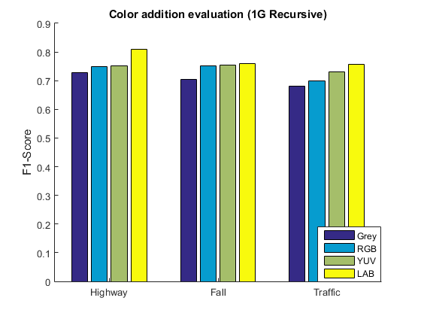
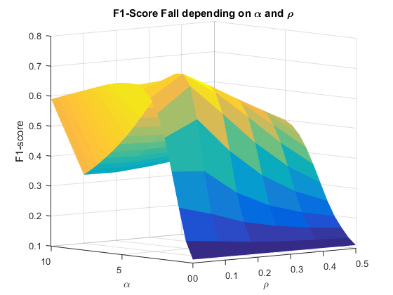
Remarks
The baseline for this block is the one obtained with the recursive gaussian modeling reported last week. The obtained results in terms of F1-score were used to fix the parameter ⍴:
This approach was reported as the best option using the lab color space:
Sequence | Alpha (ɑ) | Rho (⍴) | F1-Score
Highway | 3 | 0.2 | 0.7284
Fall | 3 | 0.1 | 0.7038
Traffic | 4 | 0.2 | 0.6796

Slide 3
Remarks
There are two ways to solve this problem and get the best parameters:
Solution A:
Apply “Recursive Gaussian Model” to generate all the masks.
Apply morphology into those masks.
Solution B:
Apply each iteration of “Recursive Gaussian Model” to generate all the masks. For each frame:
Apply morphology into this mask.
Update 𝛍 and 𝝈 using the morphology mask and/or shadow removal.
✔
Much faster to test, once you just have to calculate the “Recursive Gaussian Model”.
The morphology improves the “Recursive Gaussian Model” (update 𝛍 and 𝝈).
✔
✖
The morphology does not adapt the “Recursive Gaussian Model” parameters (not update certain 𝛍 and 𝝈).
✖
Much slower to test, must be calculated each time the model because the morphology is inside the “Gaussian Adaptive model”.
We have considered that the best solution is B.

Slide 4
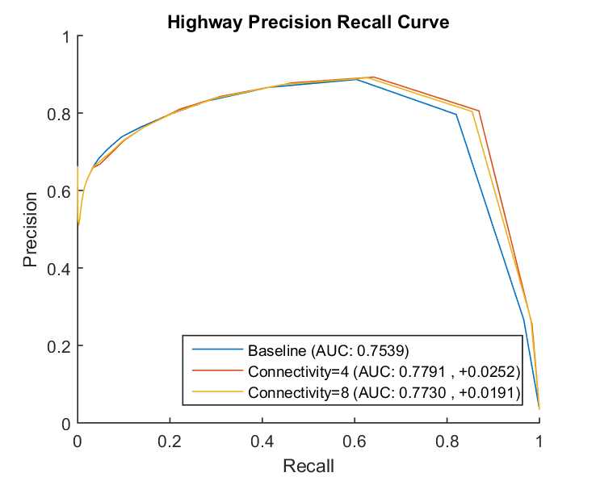
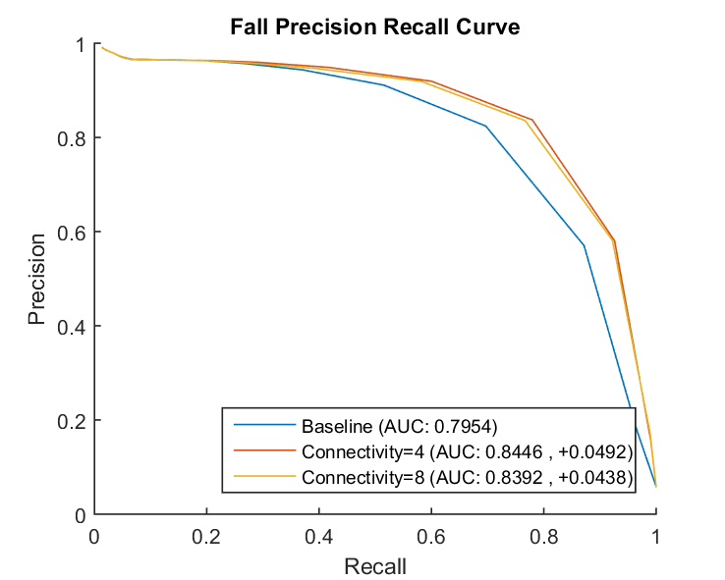
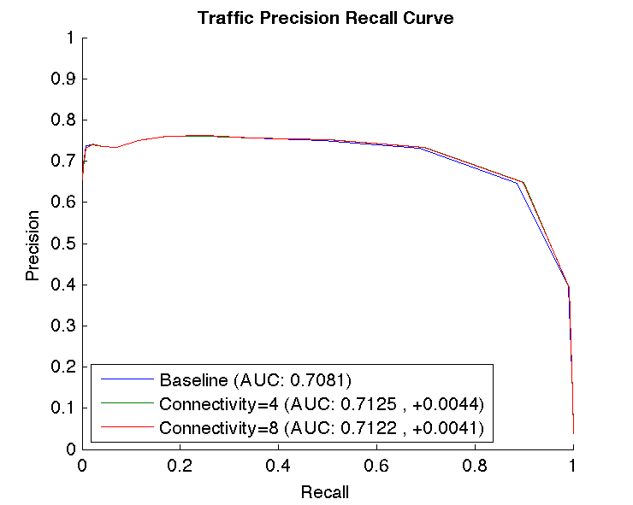
Task 1: Hole fillings
 | 4-Connectivity (AUC) | 8-Connectivity (AUC)
Highway | 0.7791 (+0.0252) | 0.7730 (+0.0191)
Fall | 0.8446 (+0.0492) | 0.8392 (+0.0438)
Traffic | 0.7125 (+0.0044) | 0.7122 (+0.0041)
Average | 0.7787 (+0.0263) | 0.7748 (+0.0166)

Slide 5
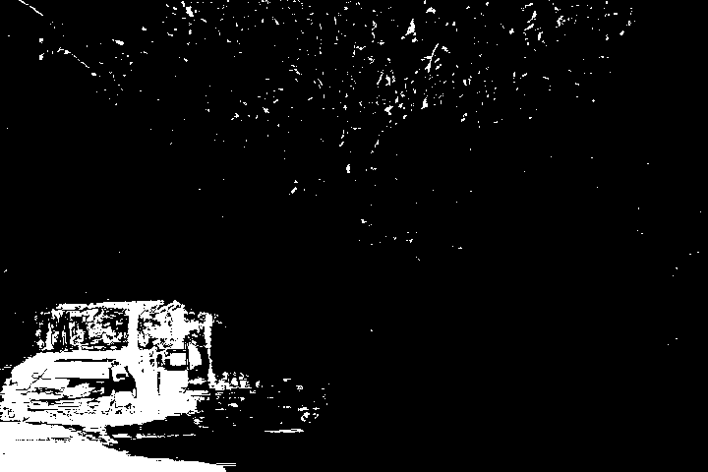
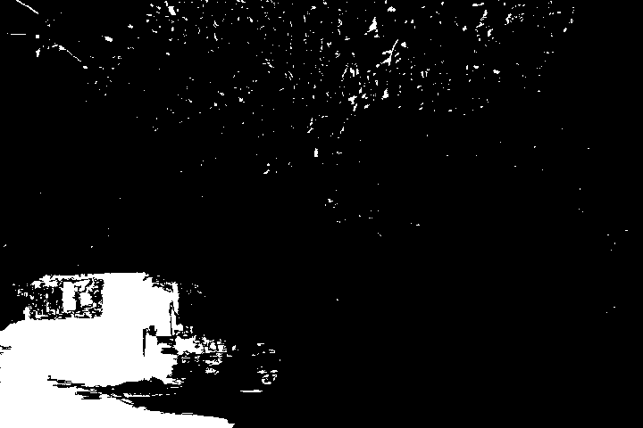
Task 1: Hole fillings
fall/001519.png
Without hole fill
With hole fill
Fall sequence is the most benefited from applying hole fill because it has lots of “noisy blobs” with holes that now are correctly filled and labeled as foreground.

Slide 6
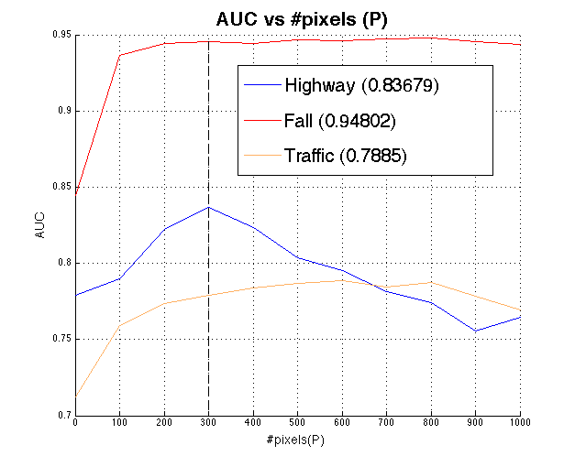
Task 2: Area filtering
In order to get the best number of pixels p for the area filtering, we have chosen p such that maximizes the mean AUC of the three sequences, which is p = 300.
The behaviour observed in this plot, indicates that both fall and traffic contain big objects (more than 400px) that are part of the background. On the other hand, the highway sequence contain small objects and applying a threshold of 150px will delete parts of the mask that are foreground and the AUC will decrease rapidly.
Optimum #pixels: 300

Slide 7
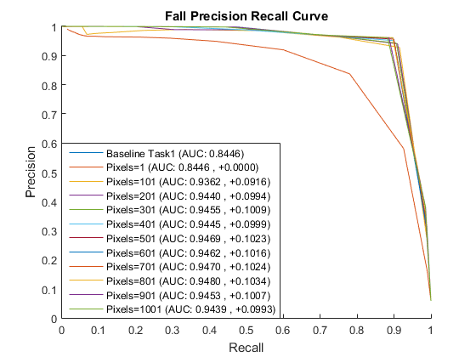
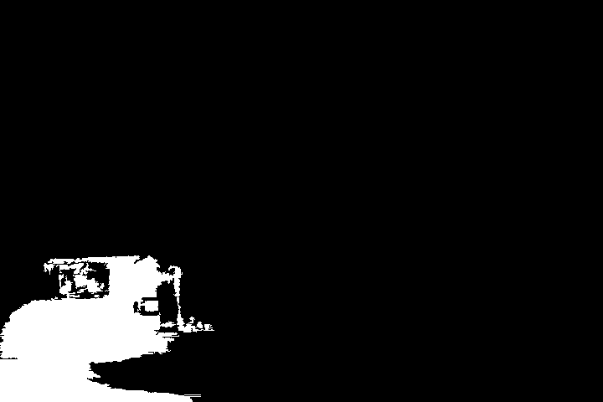
Task 2: Area filtering
fall/001519.png
Task 1 output
With area filtering
Fall sequence is the most benefited from applying area filtering because of the noise produced by moving tree leaves in the background. Hence, filtering these small blobs improves the foreground segmentation.

Slide 8
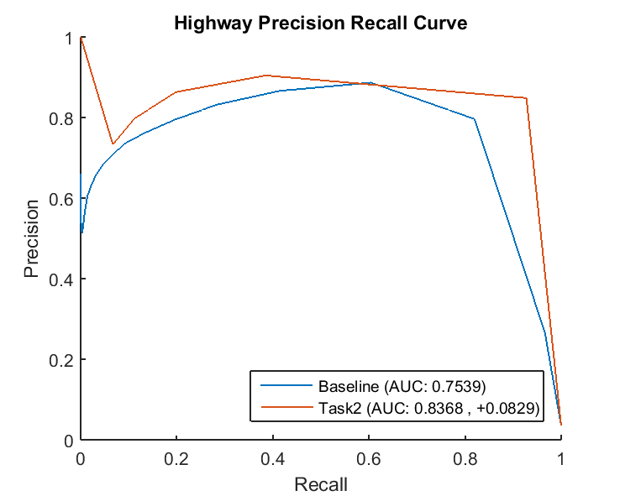
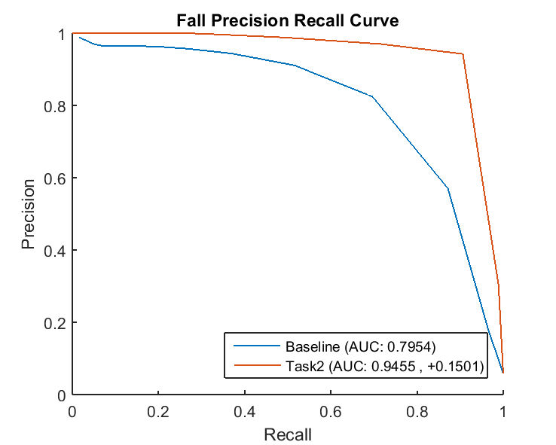
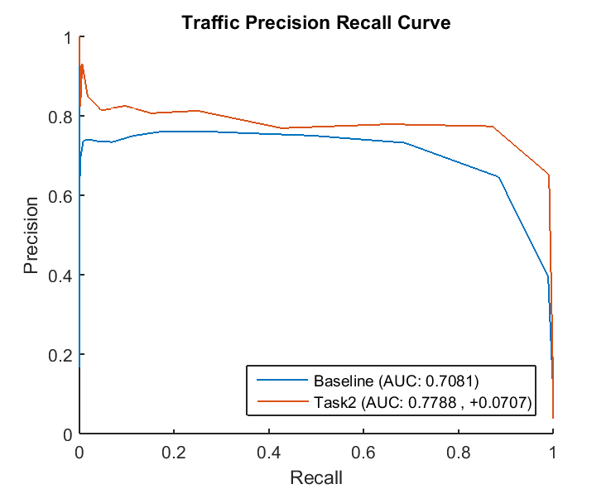
Task 3: PR and AUC
 | Best Setting: Task1+Task2 (AUC)
Highway | 0.8368 (+0.0829)
Fall | 0.9455 (+0.1501)
Traffic | 0.7788 (+0.0707)
Average | 0.8537 (+0.1012)
Tuning the parameters from Task1 and Task2 and setting the parameter to:
Hole filling: 4 Connectivity
Area filtering: 300 px
Our model improves by a 10.12% in terms of AUC compared with the baseline of the last block.

Slide 9
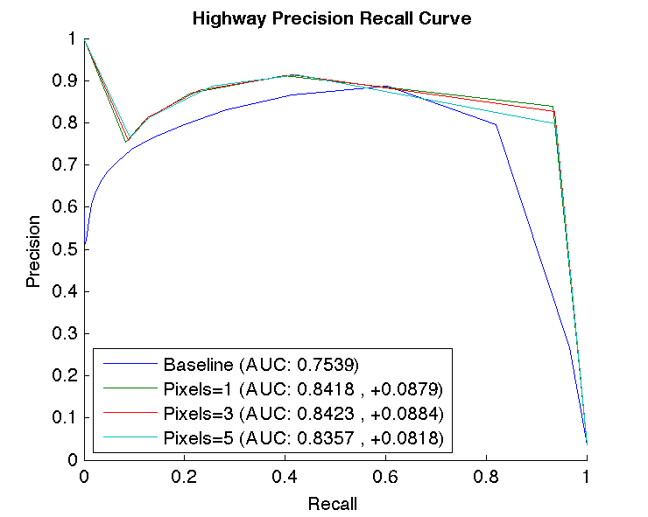
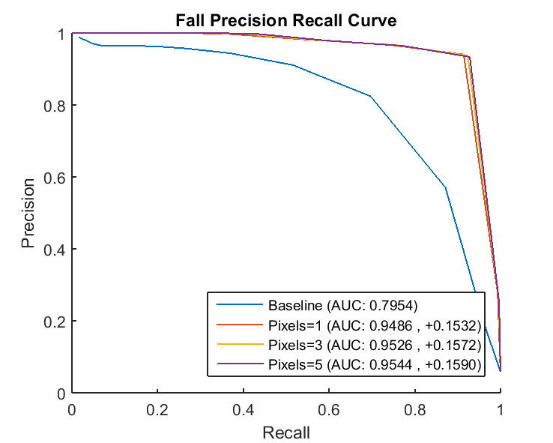
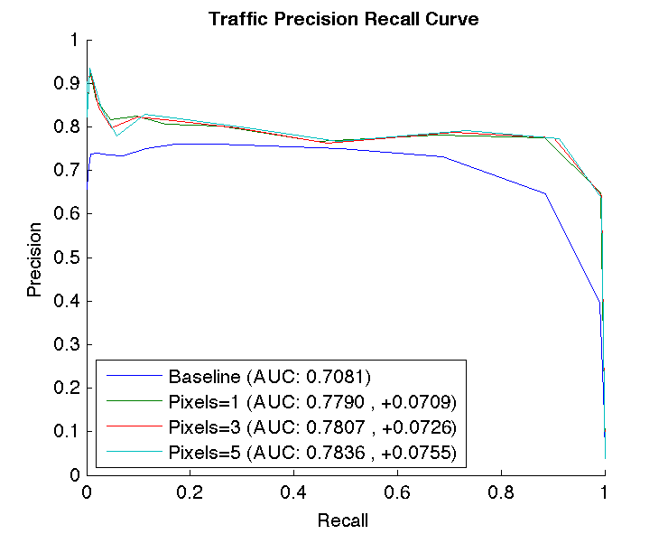
Task 4: Other solutions
The proposed pipeline for this task is:
Area filtering: Remove noise and avoid next stages to make it bigger → remove FPs
Closing: Join blobs that are close → remove FNs
Hole filling: Fill the holes of the foreground. The previous closing will help to close some parts. → remove FN
All parameters except for ɑ and the closing structure element size have been fixed. Best mean value for AUC (all sequences) is 0.8585 using size of 3 pixels for the closing.

Slide 10
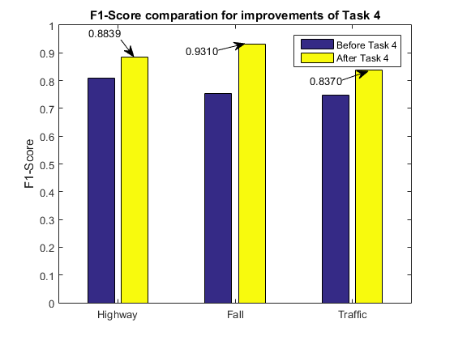

Task 4: Other solutions
It is important to do the closing after the area filtering. Otherwise, noisy FPs (tree leaves, for ex.) could be joined together, which could have a negative impact on the performance of our segmentation.
 | Task 1 (AUC) | Task 2 (AUC) | Task 4 (AUC)
Highway | 0.7747 (+0.0208) | 0.8368 (+0.0829) | 0.8423 (+0.0884)
Fall | 0.8397 (+0.0443) | 0.9455 (+0.1501) | 0.9526 (+0.1572)
Traffic | 0.7122 (+0.0041) | 0.7788 (+0.0707) | 0.7807 (+0.0726)
Average | 0.7755 (+0.0230) | 0.8537 (+0.1012) | 0.8585 (+0.1061)

Slide 11
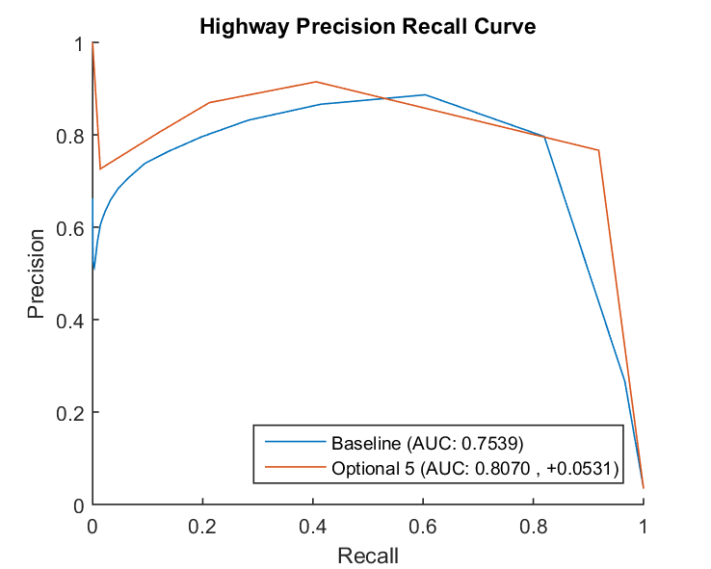
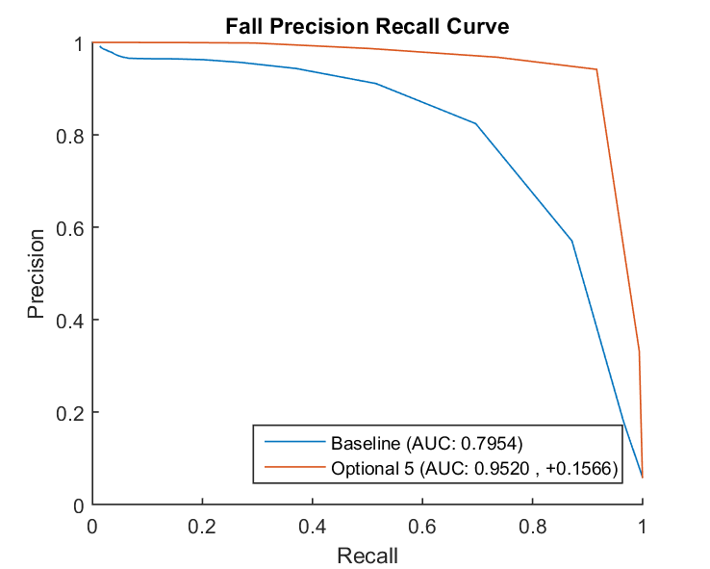
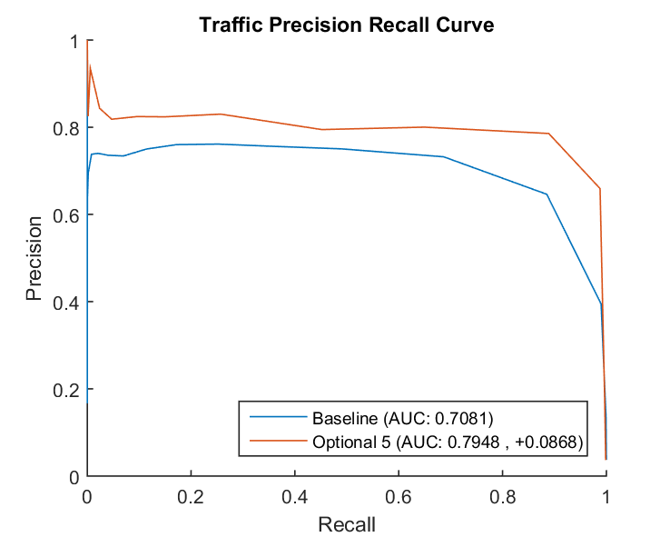
Task 5: Shadow removal
Before morphology* results:
AUC | Without morphology | Before morphology* | After morphology*
Highway | 0.6735 (-0.0804) | 0.8070 (+0.0531) | 0.7972 (+0.0433)
Fall | 0.7564 (-0.0391) | 0.9520 (+0.1566) | 0.9230 (+0.1276)
Traffic | 0.7001 (-0.0080) | 0.7948 (+0.0868) | 0.7879 (+0.0798)
Average | 0.7100 (-0.0425) | 0.8512 (+0.0988) | 0.8360 (+0.0836)
*Shadow removal can be applied after or before morphology is done. This little detail has an impact on the AUC. Shadow removal is not perfect and can alter the efficiency of morphological filters, so it is better to remove shadows before morphology.

Slide 12
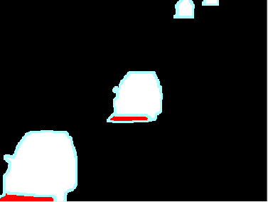
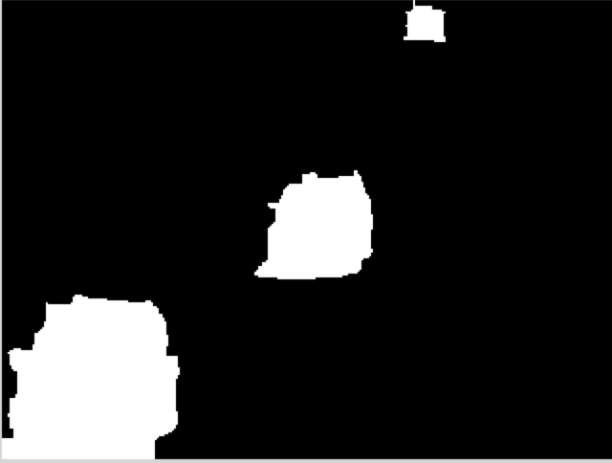

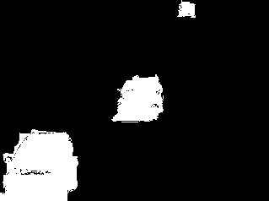
Task 5: Shadow removal
highway/001200.png
Ground truth (white=foreground, blue=unknown, red=shadow)
No shadow removal (only morpho.)
Shadow removal (before morpho.)
Shadow removal (after morpho.)
Comparing the average AUC with the Task 4 results we get to the conclusion that shadow removal is not the best tool to apply in the analyzed sequences.
The only improvement appears in Traffic sequence. There, we are able to detect shadows in blobs that have been misclassified, managing to remove FPs. The parameters have been set to the ones reported as best results by the paper:
Cucchiara, Rita, et al. "Improving shadow suppression in moving object detection with HSV color information." Intelligent Transportation Systems, 2001. Proceedings. 2001 IEEE. IEEE, 2001.
We have not obtained a good improvement by parameter-tuning them.

Slide 13



Task 6: Improved Evaluation of Foreground Maps
F1-score is a well known measure to evaluate foreground maps. However, this metric cannot distinguish which is the best between foreground maps that for a human it is very easy. Here we can see two synthetic images. Clearly, the segmentation of image 1 is better than image 2 and this is what the F₁^{w}-measure tells us taking into account the geometric information.
Ground truth
Prediction 1
Prediction 2
F1-measure = 0.4881
F₁^{w}-measure = 0.4232
F1-measure = 0.4881
F₁^{w}-measure= 0.3994

Slide 14
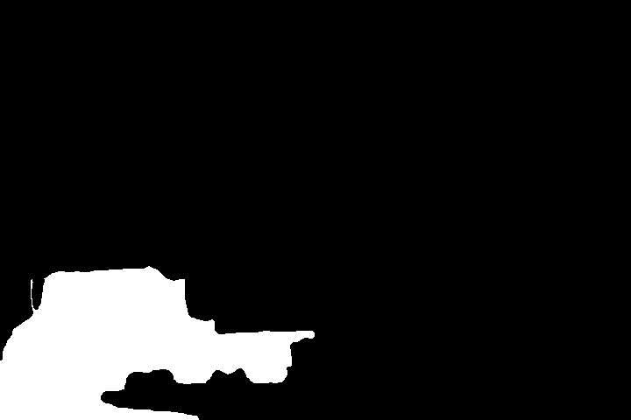
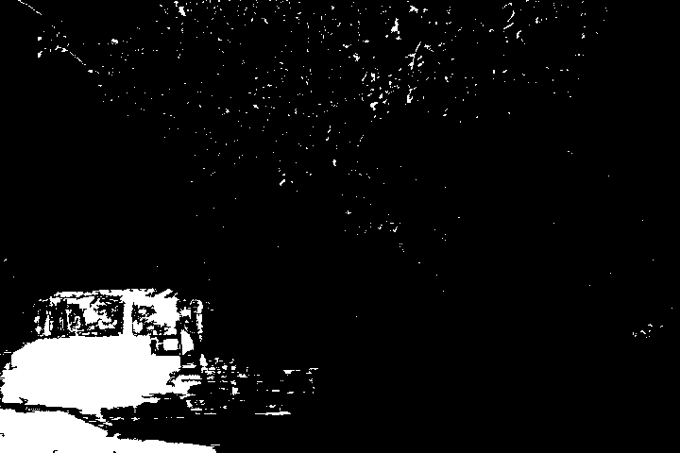

Task 6: Improved Evaluation of Foreground Maps
Similarly to previous examples, the F1-measure gives a different rank of values than the weighted F1-measure. F₁^{w}-measure gives priority to the masks that are closer to the ground-truth.
Note how the F1-measure is reduced from image 1 to image 2 and F₁^{w} has increased. Visually, humans prefer the mask provided by Image 2 because it has more foreground pixels close to the object we want to detect. This is in fact what F₁^{w} does, and so it matches our perception.
Ground truth
Image 1
Image 2
F1-measure = 0.5585
F₁^{w}-measure = 0.7644
>
F1-measure = 0.5469
F₁^{w}-measure = 0.7788
<

